Slide 1
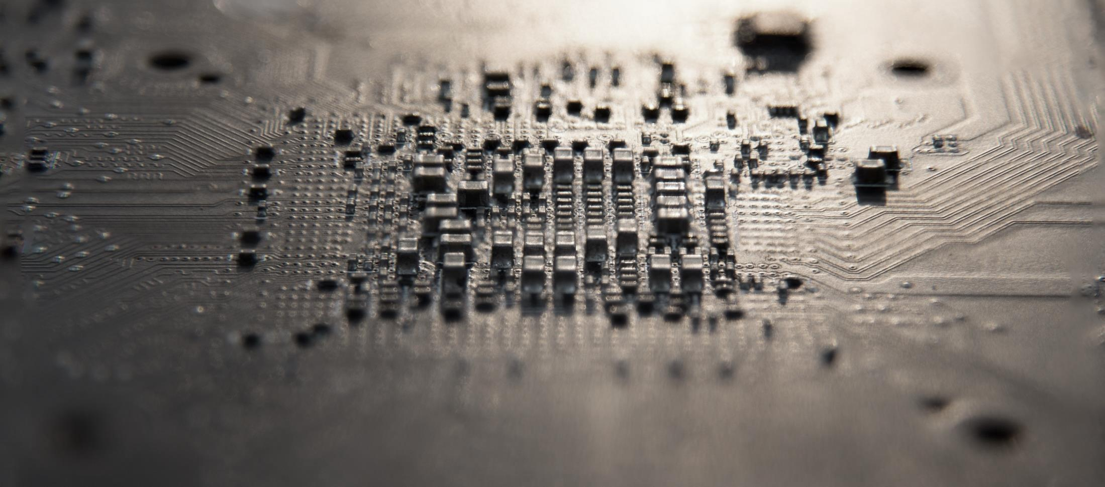
Business Plan
PhotoniSol Incorporated
A photonic technology solution provider for next generation semiconductors
https://www.photonisol.com
Commercializing the world–first optical diode (isolator) chips
for functional photonic integrated circuits
Contact:
ceo@photonisol.com, Tel. 82-10-2680-7991
Notes:
Hello, my name is Kyong Hon Kim. I am a CEO in photonisol incorporated.
Our company is developing the world-first commercial product of optical diode (isolator) chips for the photonics era of 21st century.

Slide 2
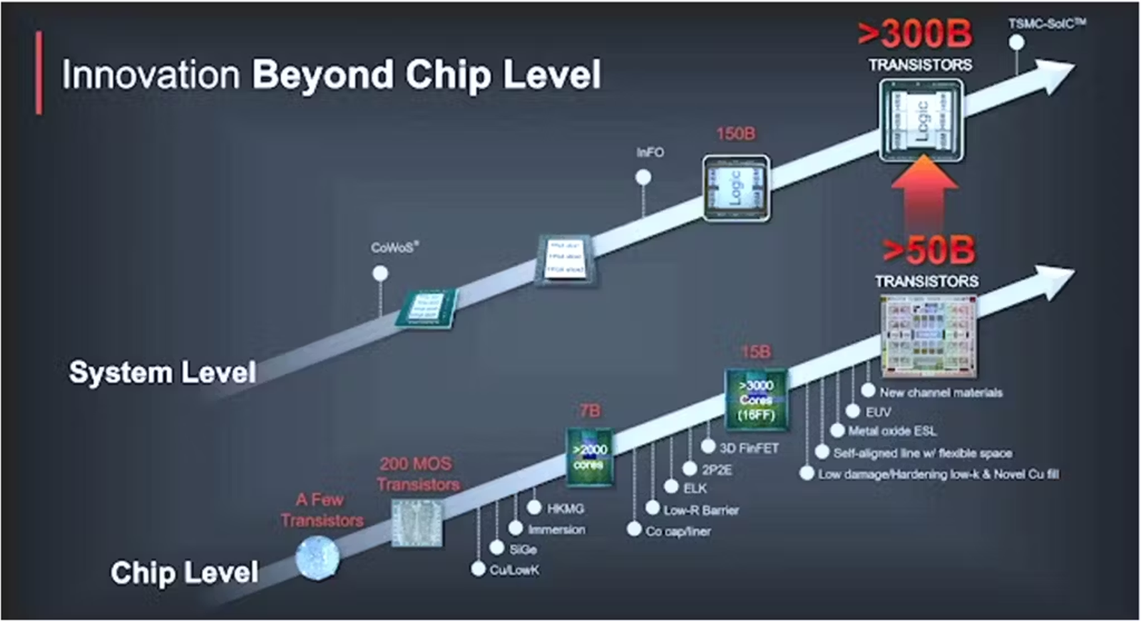
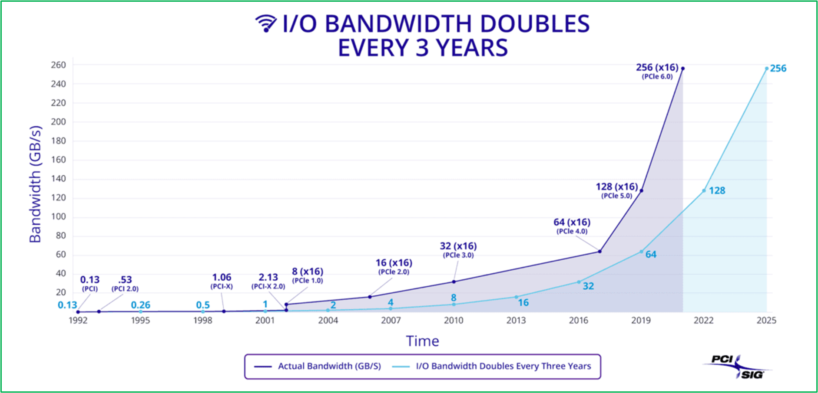
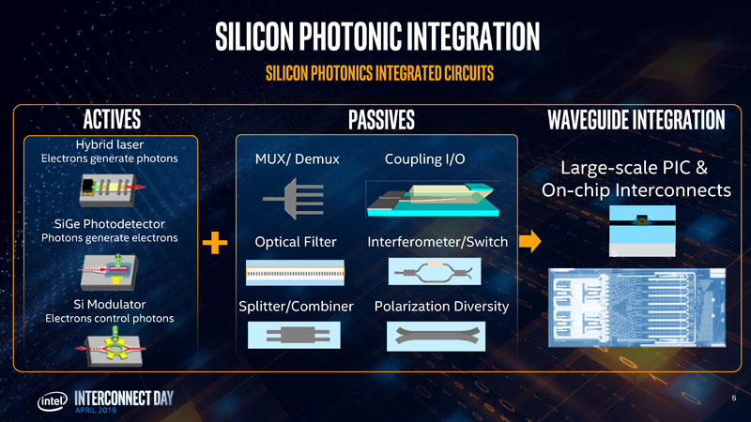
Problem – Semiconductor Technology Trend
System semiconductor technology issues
Continuous increase of semiconductor integration capacity
Rapid increase of I/O bandwidth of semiconductor chips
Limited speed increase due to thermal effect
Technical difficulty of many pin-out connections
Optical interconnection technologies are emerging to handle high-bandwidth requirement of the semiconductor chip I/Os!!
No optical isolator chip
Notes:
Recently semiconductor integration capacity keeps increasing to handle ever-growing information processing requirement.
However, the I/O bandwidth increase of the high-capacity semiconductor chips is very rapid, and it pushes the electrical interconnection technologies to a technical limit.
The photonic interconnection technologies are emerging to handle the high bandwidth requirement of the semiconductor chip I/Os..
Intel has demonstrated most of photonic devices for the optical interconnection technologies except the optical isolator chip which is very important for photonic integrated circuits and optical interconnect applications.

Slide 3
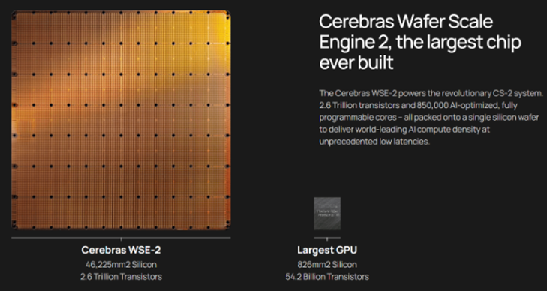
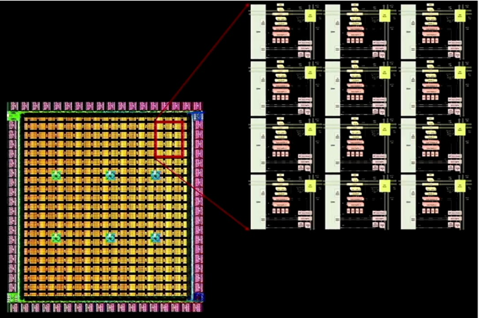
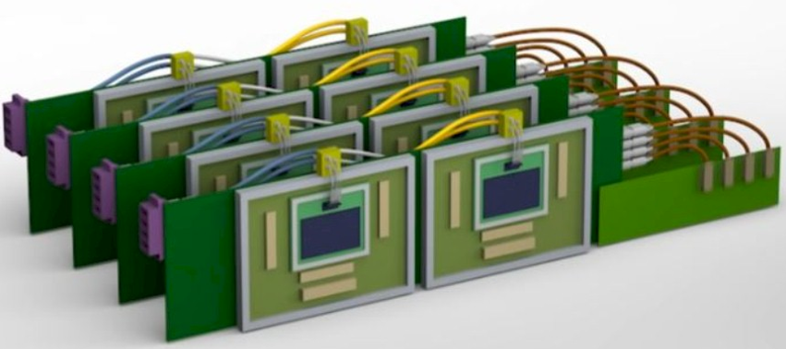

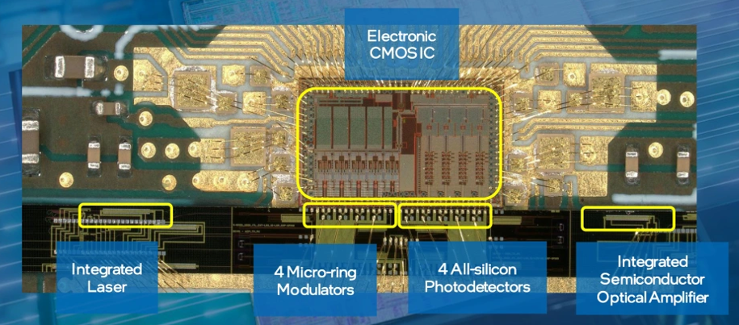
Problem – AI Computer Technology Trend
AI computers make decisions through high-capacity processes based on massive machine-learned data.
Cerebras’ AI accelerator
2.6 trillion transistors, 850,000 cores
Series F funding ($250M, $4B+ valuation) Nov. 2021
Tesla’ Dojo chip to have AI machine learning and neural network training for self-driving automobiles
50 billion transistors, 53,000 cores
Emerging silicon photonics technologies for high-capacity signal I/Os between massive memories and super CPU chips
Nvidia’s GPUs and memories connected by optical fiber interconnects
ChatGPT uses >30,000 GPUs
6 round funding (total $4.1B) May 2023
Inte’s silicon photonics platform for high-performance computers
Notes:
Recently significant efforts to build hyperscale AI computers are being developed by major IT companies.
Cerebras has announced a wafer-scale AI accelerator based on the entire 12-inch silicon wafer with 2.6 trillion transistors and 850 thousand cores.
Tesla also demonstrated a Dojo chip to have AI machine learning and neural network training for self-driving automobiles with 50 billion transistors and 53 thousand cores.
Nvidia’s GPUs are connected to each others and to memories with optical fiber interconnects which need to be replaced by photonic-integrated optical interposers.
ChatGPT uses more than 30 thousand GPUs for interactive AI service systems.
Intel has also developed silicon photonics platform for high-performance computer applications.
These days silicon photonics technologies become very important for high-capacity signal I/Os between massive memories and super CPU chips.

Slide 4
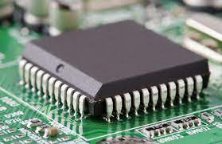
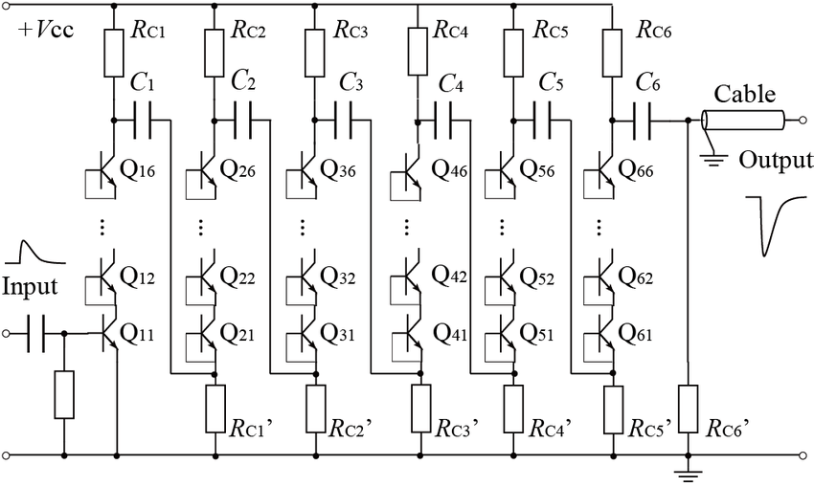
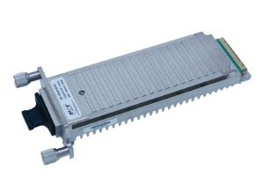
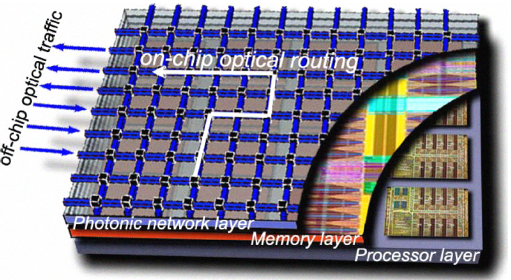
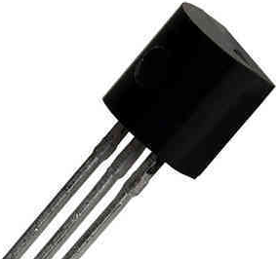
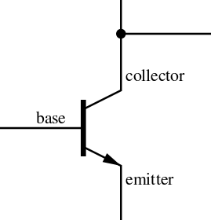
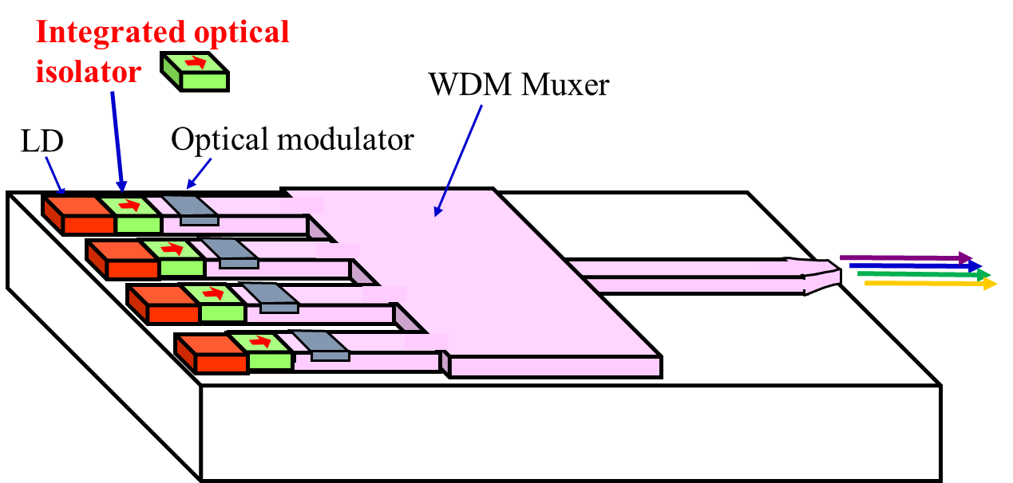
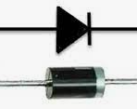


Problem - Why optical diode?
Practically useful optical diode (optical isolator) chip needed
In electronics, electrical diode is a basic element to build up signal processing circuits
In photonic ICs, optical isolator (diode) is a basic element to build up photonic interconnect circuits (PICs).
Notes:
In the electronic technology, the electrical diode is a basic element to build up transistors and electronic integrated circuits.
Similarly in photonic technology, “”optical isolator””, which is also called as “”optical diode””, is “a basic element” to build up photonic integrated circuits.
Presently no practically useful optical diode chips are available except bulk-type optical isolators.
Thus, “optical diode chips” based on silicon photonics are very important to build-up massively integrated photonic circuits.

Slide 5
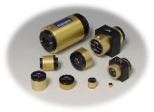
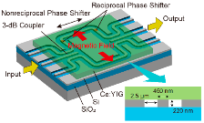

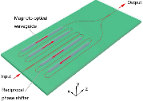


Problem
No commercially available optical diode (optical isolator) chips
- a key device for photonic integrated circuits based on silicon photonics -
(Present) bulk-type optical diodes
- unsuitable for integration
- only packaging process
→ no good for mass producing
Optical diode chip (optical isolator chip)
- seek for a silicon photonic chip suitable for mass producing semiconductor processes
- relatively easy to integration
(competitive technology development races)
Notes:
Presently most of lasers including laser diodes in optical transmitters require optical isolators for stable laser operation.
Only bulk-type optical isolators are available presently.
Significant efforts are being paid by many research groups worldwide to develop optical diode chips.

Slide 6
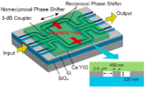
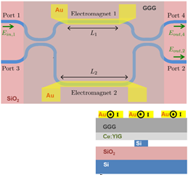
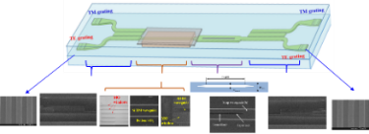
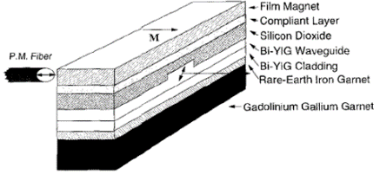
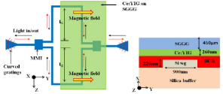

Competition
Comparison of optical diode chip technologies under development
Types | Magneto-optic waveguide type | Magneto-optic material bonding types | PLD-based monolithic integration type | Magneto-optic film coating method (our approach)
Major charac-teristics | Uses magneto-optic material waveguides | Magneto-optic materials are bonded on silicon waveguides | Pulsed laser deposition (PLD) based monolithic integration on silicon waveguides | A new optical diode chip scheme with direct spin or sputtering coating of MO films on Si waveguides
Pros/ cons | . Relatively high loss . Not suitable for photonic integration | . Not suitable for mass-producing . require packaging | . Not suitable for mass-producing & semiconductor fab. | . Mass production coating process is suitable for semiconductor fab.
Major players | Bell Labs., Columbia Univ. | Tokyo Institute of Techn. UC Santa Babara, Ghent Univ. | MIT, Univ. of Electronic Science & Techn., China | Inha Univ. PhotoniSol Inc.
Various approaches to the optical diode chips are under development in many world research institutes, but none of them is suitable for mass-producing with semiconductor fabrication processes yet.
Notes:
Various approaches to the optical diode chips are under development in many world research institutes, but none of them is suitable for mass-producing with semiconductor fabrication processes yet.
In early 1990s, researchers in Bell Labs and Columbia university demonstrated an optical isolator chip based on special magneto-optic materials. However, this device has a significant drawback in integration with other devices due to its special material-based structure.
After 2000 millennium, silicon photonic technology has been emerged. Professor Mizumoto in Tokyo Institute of Technology and Professor John Bowers in UC Santa Babara demonstrated optical diode chips by bonding a magneto-optic film on the silicon photonic waveguides. However, this device approach is not good for mass production.
Researches in MIT and Chinese alumni researchers demonstrated optical diode chips by depositing magneto-optic film directly on silicon waveguide using pulsed laser deposition method.
However, this pulsed laser deposition (PLD) method is not good for mass production of the MO films.
Beside these approaches, many good research papers are being reported recently in famous technical journals, such as Nature and Science. However, most of them are not suitable for mass production with existing semiconductor production lines.
In our approach, we developed a new optical isolator chip scheme with either direct spin or sputtering coating of magneto-optic materials which is suitable for mass production in semiconductor lines.

Slide 7
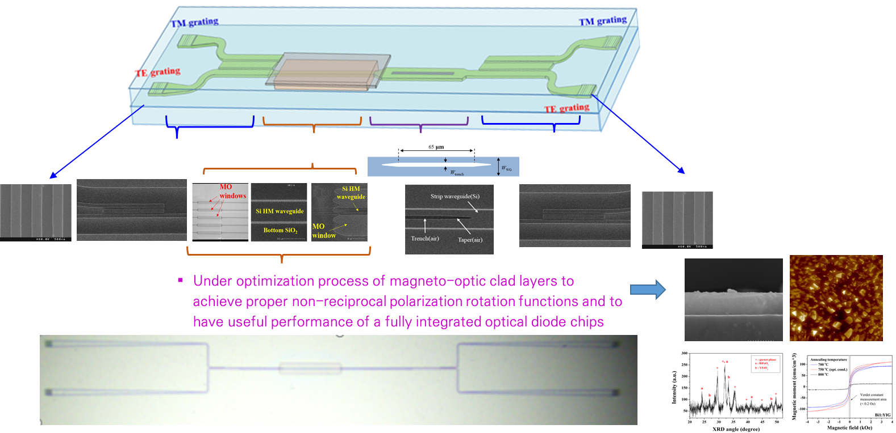
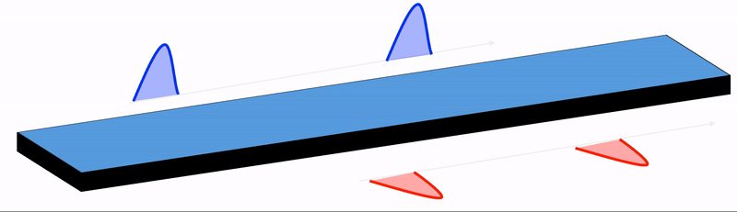

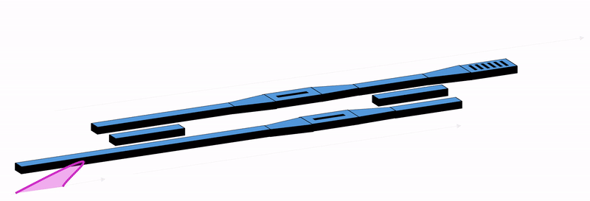
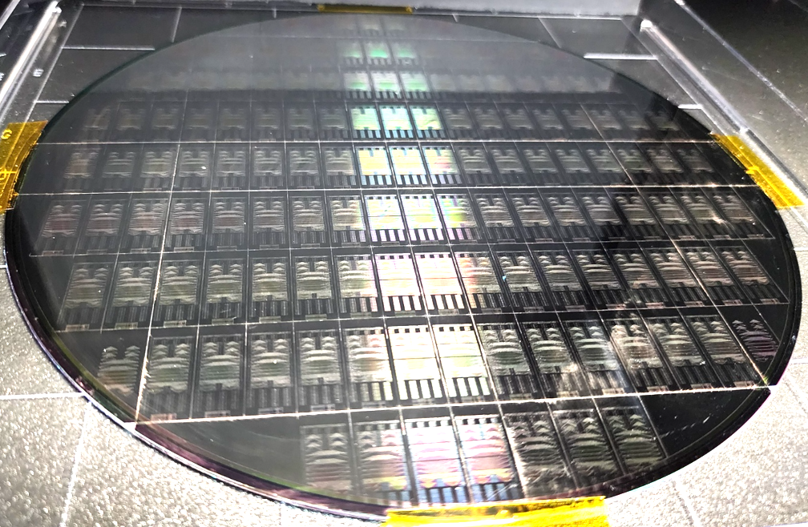

Solution
Optical diode chips suitable to semiconductor fab processes and mass production
World first attempt of optical diode chips suitable to mass production-enabled semiconductor fab processes.
A key device to enable massive integration of photonic integrated devices
Notes:
We are developing optical diode chips suitable to the existing semiconductor fabrication lines and mass production.
This is the world first attempt to commercialize optical diode chips based on the silicon photonics and the semiconductor fabrication lines.
We are working on demonstration of the optical diode chips up to the field-level performance.

Slide 8
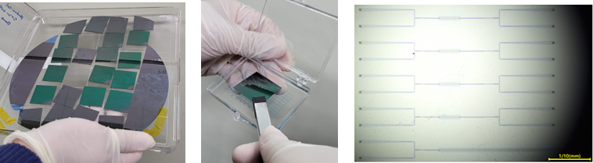
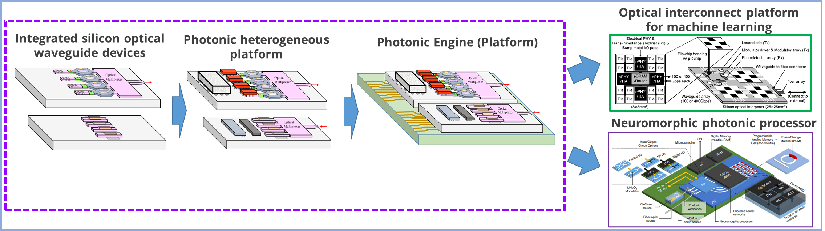
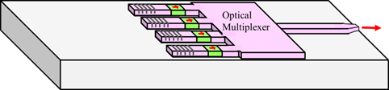
Product
Optical diode chip
Target performances
Insertion loss: < 2 dB,
optical isolation: > 25 dB (Ultimate target: < 1 dB insertion loss & > 30 dB optical isolation)
Notes:
We are trying to deliver optical isolator chips into market within a year so.
Presently we are working hard to optimize the semiconductor fabrication processes to achieve a useful device performance.
The photonic devices require more delicate fabrication processes than those used in the conventional electric devices.
We expect to have an optimized device performance soon.

Slide 9
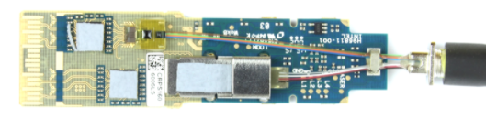



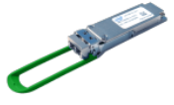



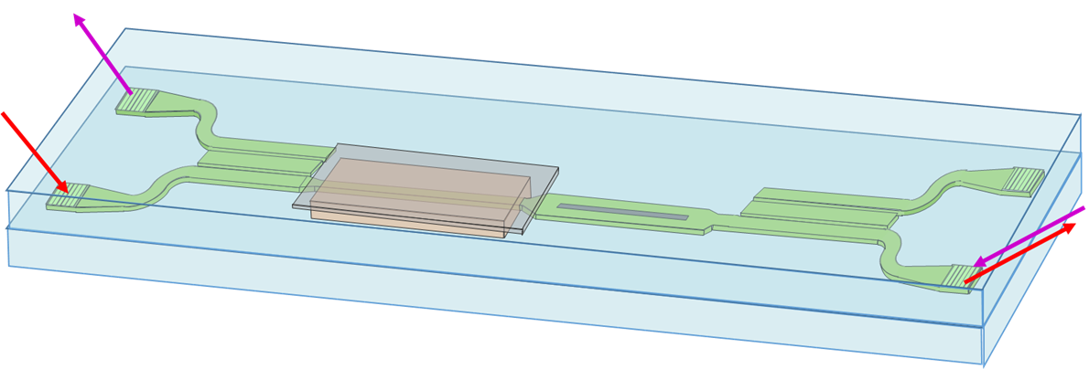
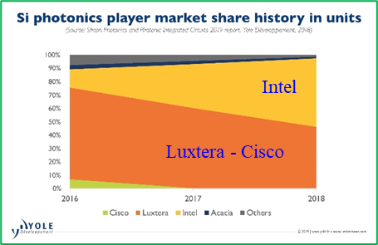

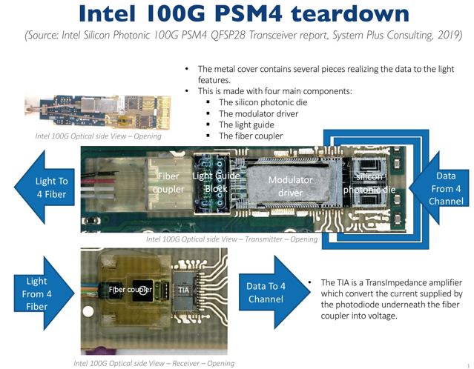

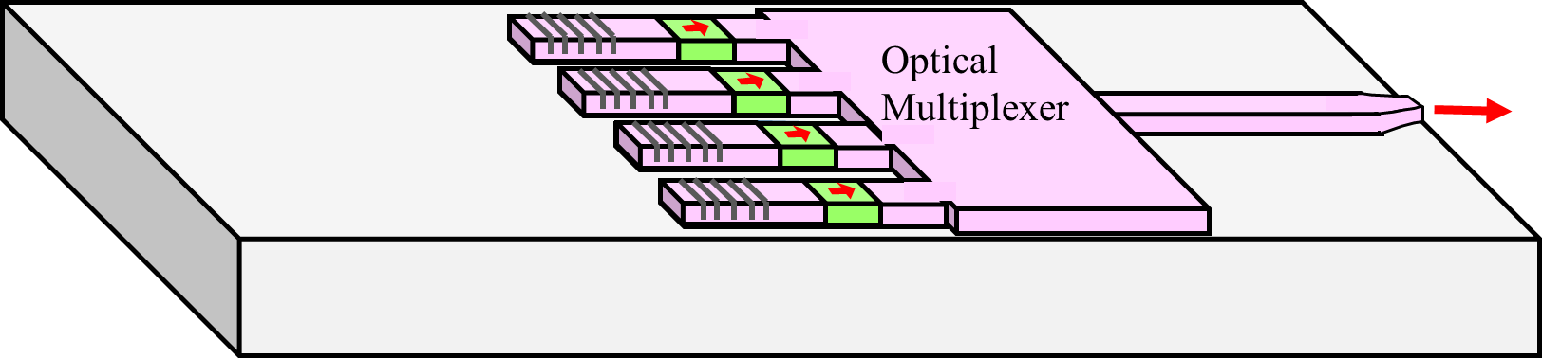
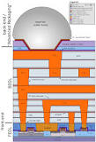

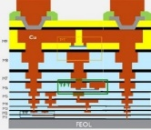










Business Model
Optical transceiver applications
Optical diode chip &
Optical passive platform
Opto-electric IC (optical interconnect) applications
Notes:
Our optical diode chips can have potentially immediate markets by replacing the present bulk-type optical isolators in optical transceiver modules.
In addition, the optical diode chip will be very useful to major semiconductor companies for next generation hybrid electronic and photonic ICs.

Slide 10
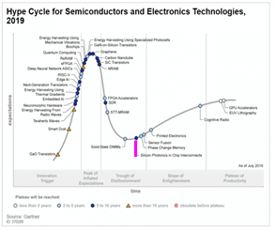
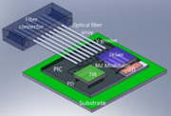
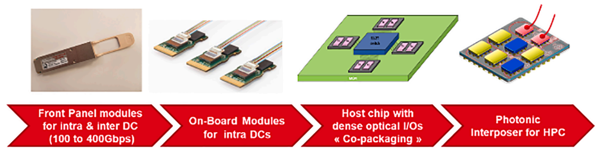

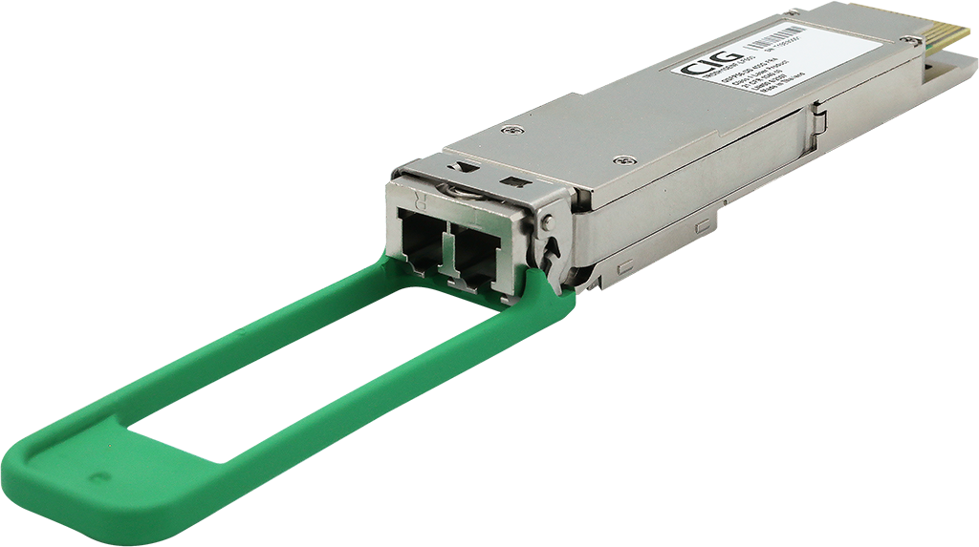

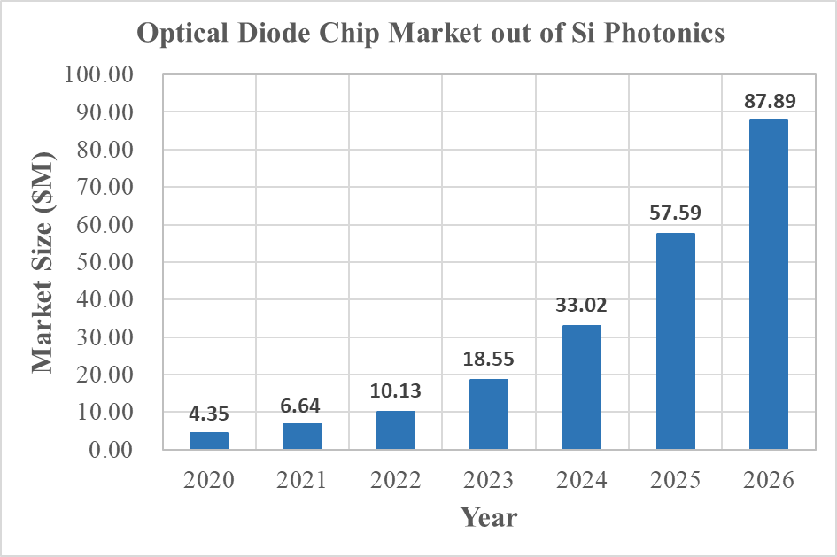
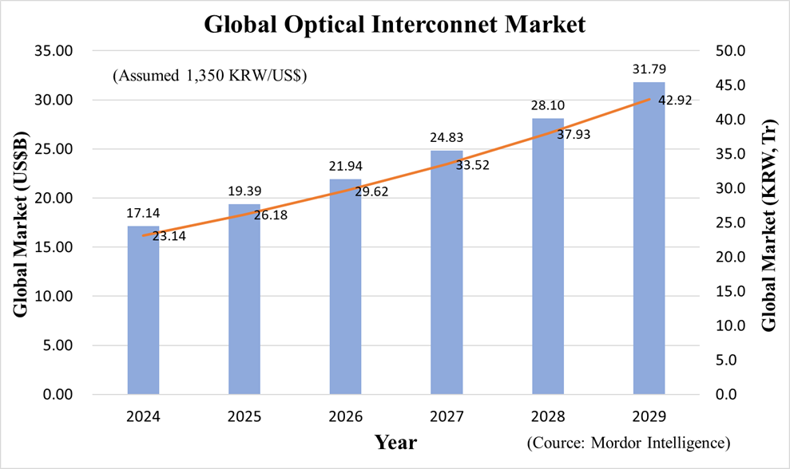
Market Opportunity
Optical transceiver market for Data center applications
Machine-learning & AI computer market
Market share plan
Entering market
Market entering
Calculated estimation from
Yole development – Silicon photonics Market and Technology report 2021
https://www.marketsandmarkets.com/Market-Reports/optical-interconnect-market-89222473.html
Market share plan: Several M$ (2024) → several tens M$ (2025)
Market share plan: Several M$ (2025) → hundreds M$ (2027 & after)
Notes:
We expect to have some market share by replacing the existing bulk-type optical isolator used in present optical transceiver modules for data center applications.
We also expect some market share with semiconductor devices in the next generation machine-learning and AI computer applications possibly from 2025.

Slide 11



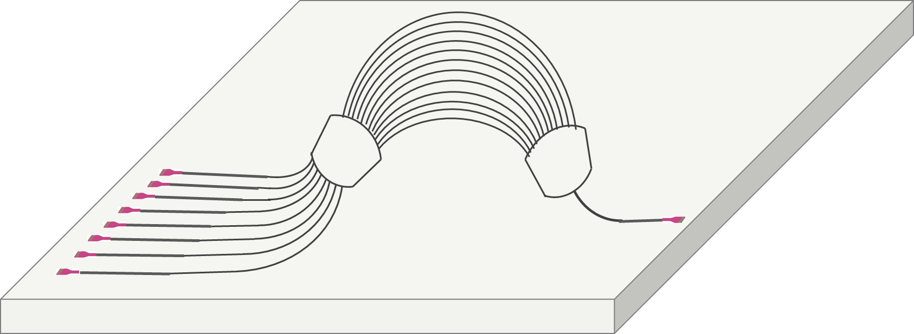
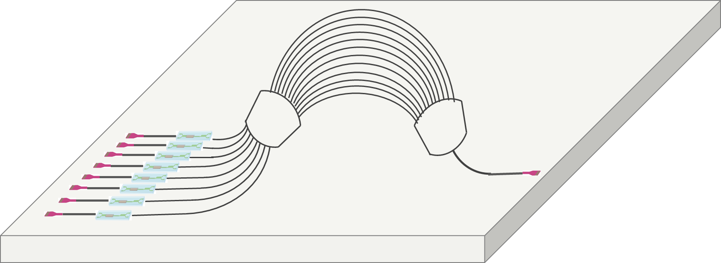
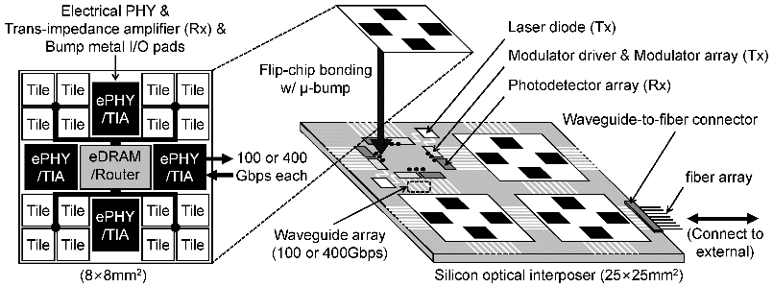
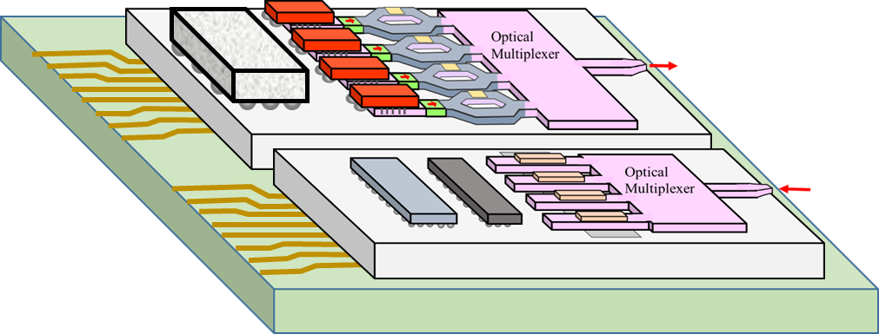
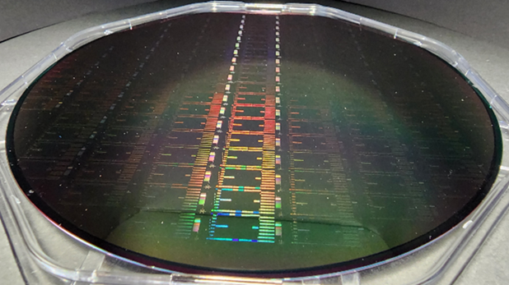


Business Time Plan
Phase 1
Technology maturization
Phase 2
Entering market
Phase 3
Technology/product sales & next R&D
Year 2022
Year 2023
Year 2024
Year 2025
Year 2026
Year 2027
Year 2028
Optical diode chip development
Opt. diode chip tech. sale
Technology sale
or M&A
Product sales
(device performance achievement)
WDM chip develop & integration
WDM & isolator/ optical interposer platform sale
Tbps optical TRx sale
Commercialization & Sales plans
WDM & isolator integration
Photonic SoC network chips/ module development & sales
Optical modulator chip
modulator & isolator integration
Facilities/equipments/ finance plan
Collaboration with dedicate silicon nano foundry center(s)
Post device processing facilities
Government R&D project, Loan & Investment
- Initial funding from KOREA TECHNOLOGY FINANCE CORPORATION & private funding associations
- New funds for foundry service & post processing equipment
Operate own mass production lines
Manpower increase for mass production and R&D activities
Expanding sale markets
Self supporting operation w/ own income from technology & product sales
Becomes a global leading photonic integrated circuit manufacturer
Notes:
We are planning to enter market soon by having the field-level performance of the optical diode chips.
Based on our optical diode chip we will proceed to photonic integrated circuits by collaborating with silicon foundries and by performing post device processing.

Slide 12








Team
Kyong Hon Kim
HanYoul Ryu
Kyu-Tae Lee
Seung Hwan Kim
Beomsu Park
Ji Woon Park
Hyo-Seung Park
CEO
(Ph.D., Physics)
Technical Director
(Ph.D., Physics)
Technical Co-director
(Ph.D., Electrical Eng.)
Director, R&D
Senior Researcher
Researcher
Researcher
Laser development for spaceborne lidars in NASA
Director, Optical communications devices at ETRI / National R&D project planning member
Former professor of Physics, Inha Univ. / >15 years R&D in silicon photonics devices
Optical diode chip development over 10 years
Semiconductor photonic device at NTT Basic Lab., Japan
Display and semiconductor devices at Samsung R&D Institute
Over 10 years R&D on integrated optical waveguide devices.
Director of photonic integrated circuit design
Nano optics and semiconductor photonic device R&Ds at Univ. of Michigan and at Univ. of Illinois
Nano-optics and optical system R&D at Toyota USA Research Center
Assistant professor of Physics, Inha Univ./ Optical thin film R&D
Lead thin film and waveguide research
Design, simulation, and characterization of optical waveguide devices
Ten years experience of industrial semiconductor measurement system development
R&D on Optical diode chips and LC cell devices
Ten years experience of industrial semiconductor measurement system development
Development of 2D and 3D optical systems
R&D on thin films of magneto-optic materials and their device applications
Development of magneto-optic materials.
Characterization of magneto-optic films for optical diode chips
Optical characterization of magneto-optic thin films and design of silicon waveguide devices
Research on sputterred magneto-optical films
Younghyun Kim
Technical Advisor
(Ph.D., Electrical Eng.,
Univ. of Tokyo)
Professor, Hanyang Univ.
An expert on silicon photonics & opto-electronic integrated circuits
Notes:
We have seven members presently including highly technical oriented experts in photonics and nano-optics areas.

Slide 13

Company history
2023. 10. 12
Investment from private funding associations (0.23 $M)
2023. 8. 10
Investment from Hanayng Univ holding & private funding (0.3 $M)
2022. 12. 26
Investment from a private funding (Nautilus, 15 $K)
2022. 5. 20
Investment from private funding associations (0.3 $M)
2021. 6. 22
Investment from Korea Technology Finance Corporation (0.22 $M)
2023. 7.
3-year deep tech tips project (1.15 $M)
2022. 7.
2-year project for venture technology development
2021. 4. 2
Loan from Korea Technology Finance Corporation (0.26 $M)
2022. 3. 5
3-year government project for system semiconductor technologies
2020. 7. 1
Startup as a university lab. company
Total fund raised ≈ 3 $M
PHOTONISOL
12
Notes:
PhotoniSol is a technical venture company launched with spin-off technologies from a University Research laboratory.
So far the total fund raised from investments, loan and government projects is about 3 million US$.

Slide 14




PhotoniSol aims to be a global solution company in photonic integrated circuit technologies !!
Thank you for your attention.
Contact:
ceo@photonisol.com
Notes:
Our company PhotoniSol is working hard to be a global solution company in photonic integrated circuit technologies !!
Thank you for your attention.

Slide 15

Supplementary materials
- Next generation semiconductor technology

Slide 16




















Value Chain
Si photonics discrete devices
Si photonics modules
IT Equipment
IT Service Operator
AWG, Modulator,
DC couplers, WDM filter,
PBS, MMI, Polarization rotator,
Ge detector,
Optical isolator (diode)
100G TRx, 200G/400G TRx,
800G TRx, 1.6T TRx, 3.2T Trx
5G, Cloud/Edge Routers/Switches(25.6/51.2 T),
1T/2T/4T/8T storages
Data center, Network services,
Cloud computing, Cloud storage, Communications
Intel, Cisco (Luxtera, Acacia),
Inphi, NeoPhotonics, Fujitsu,
Shmere, SiFotonics, Rockley
MACOM, Hewlett Packard, Cisco, Fujitsu, Juniper, Luxnet Accelink, FiberHome, TrueLight
Google, Facebook, Aurora,
Microsoft, Amazon, Ericsson,
NTT, Orange Labs
차세대 대용량 정보처리용 CPU, RAM들 간의 광 배선(BEOL) 집적형 광전집적회로 기술
Juniper, POET, Intel,
Cisco (Luxtera, Acacia),
Ayar Labs. Senter,
NeoPhotonics, Fujitsu, Cello,
Rockley, PhotoniSol, etc.
Samsung, Intel, Apple, AMD, Qualcomm, SK-hynix, IBM, NDIVIA, Microsoft Azure, Dell, etc.

Slide 17














Technology Roadmap
Si photonic devices
High-capacity optical transceivers
1.6T
transceivers
3.2T
transceivers
Passive devices
LD integrated WDM platform
400G, 800G transceivers
Mux/Demux
Optical filter
Splitter/Combiner
Polarization diversity
Photonic integrated circuits (PICs) / Hybrid opto-electronic integrated circuits (OECIs)
Isolator-integrated active & passive devices
Isolator-integrated active & passive modules
PIC
Hybrid OEIC
Integrated isolator (diode)
Active devices
Hybrid laser/
Amplifier
SeGe photodetector
New sensors based on PICs & hybrid OEICs
Si modulator
Switches/Interferometers
Notes:
광 다이오드 칩은 앞으로 레이저 광원과 다파장 채널파장다중화 소자와 집적화된 다파장 채널 광원 플랫폼으로 발전하여 기존의 광송수신 모듈의 용량보다 더 큰 400G, 800G, 1.6T, 3.2T급 광송수신 모듈 개발로 발전될 전망임.
한편으로는 광변조기 및 스위치 등과 같은 능동소자와 다양한 수동 소자들과 집적화하여 광자집적회로로 발전하고 나아가서는 전자집적회로와 혼합 집적화된 광전 집적회로 기술로 발전될 것으로 전망됨.

Slide 18


Slide 19


Slide 20

Evolution of multi-die solutions
Source: Cadence
https://semiengineering.com/more-than-moore-reality-check/

Slide 21

Bulk-type optical isolators being used presently

Slide 22

Intel’s integrated photonics prototype features an electronic CMOS IC
stacked on top of a photonics IC in a 3D package, combining the benefits of silicon integrated circuits and semiconductor lasers.
https://venturebeat.com/business/intel-advances-in-silicon-photonics-can-break-the-i-o-power-wall-with-less-energy-higher-throughput/

